Slide 1
Forward Chaining Systems
also known as Production Systems or Expert Systems
  e.g. diagnosis systems for medical, financial/corporate, or mechanical systems
  also used for cognitive models of reasoning (e.g. ACT)
    model of long-term and short-term memory, with activation of concepts by association
one advantage of ES is that they can generate explanations of their recommendations (i.e. a proof-tree showing the rules and facts that were used to support their conclusions)
restriction: knowledge based must consist of facts and conjunctive rules (Horn clauses)

Slide 3
Forward-Chaining System Architecture
WORKING
MEMORY
INFERENCE
ENGINE
PATTERN
MATCHER
EXECUTION
ENGINE
RULE
BASE
AGENDA
Notes:
Here you can see how all the parts fit together.

Slide 4
Rete Algorithm
representation of knowledge as a network, where nodes represent literals (predicates)
rules link antecedents to consequents
start by activating nodes corresponding to initial facts
uses efficient indexing of predicates to determine which rules can fire
in each iteration, determine which rules can fire
pick one (with highest priority) and modify the network
run until quiescence
produces all the consequences of the facts

Slide 5
Example Rete Network from: www.ai.mit.edu/courses/6.034b/rete-soln.pdf

Slide 6
Conflict Resolution
a common issue in FC that has to be dealt with
What happens when two rules can fire that have opposite effects?
  some rules can retract antecedents of other rules
  e.g. one rule says assert(P) and the other says retract(P)
  assign numeric priorities to rules – highest wins
Subsumption Architecture (Rodney Brooks)
  intelligent behavior in robots can be produced in a decentralized way by a lot of simple rules interacting
  divide behaviors into lower-level basic survival behaviors that have higher priority, and higher-level goal-directed behaviors
  example: 6-legged robot ants learning to walk

Slide 7
JESS - Java Expert System Shell
developed by Ernest Friedman-Hill at Sandia (https://herzberg.ca.sandia.gov/)
evolved from CLIPS (C-language Integrated Prod. Sys.) at NASA
Java implementation of Forward-Chaining and Rete algorithm
can interface reasoning with GUI, controllers, etc.
example of syntax for rules:
(defrule library-rule-1
(book (name ?X)
(status late)
(borrower ?Y))
(borrower (name ?Y)
(address ?Z))
=>
(send-late-notice ?X ?Y ?Z))

Slide 8
Example in JESS
engine: wont_start
ignition_key: on
(deffacts trouble_shooting
(car_problem (name ignition_key) (status on))
(car_problem (name engine) (status wont_start))
(car_problem (name headlights) (status work)) )
(defrule rule1
(car_problem (name ignition_key) (status on))
(car_problem (name engine) (status wont_start)
(car_problem (name battery) (status OK))
=>
assert (car_problem (name starter) (status faulty))) )
(defrule rule2
(car_problem (name headlights) (status work))
=>
assert (car_problem (name battery) (status OK)) )
slots
headlights: work
battery: OK
starter: faulty

Slide 10
PROLOG
"logic programming" - computation based on backward chaining
SWI-Prolog (www.swi-prolog.org/)
syntax
  based on definite clauses (conjunctive rules)
  rules written backwards
    head :- antecedents.
    head ← antecedents (read ":-" as "if")
    ∀X car(X)^dead(battery(X))→wont_start(X)
    wont_start(X) :- car(X), dead(battery(X)).
  predicates can have arguments consisting of constants, variables (start with upper case), or functions (nested)
  variables are implicitly universally quantified
  commas mean 'and'

Slide 11
queries in PROLOG
  type a fact into interpreter -> yes or no. (true or false)
  executes back-chaining (possibly with back-tracking)
    multiple rules create choice-points
  if fact has variables, will list bindings that make it true
  knowledge base (.pl file):
  bird(X) :- canary(X).
  bird(X) :- penquin(X).
  bird(X) :- owl(X).
  canary(tweety).
  canary(woodstock).
  owl(hedwig).
  interpreter:
  ?- bird(tweety).
  yes.
  ?- bird(B).
  B = tweety.
  B = woodstock.
  B = Hedwig.

Slide 12
PROLOG KB:
criminal(X) :- american(X), weapon(Y), sells(west,Y,Z), hostile(Z).
weapon(Y) :- missile(Y).
hostile(Z) :- enemy(Z,america).
sells(west,m1,nono).
missile(m1)
enemy(nono,america).
query:
?- criminal(A).
A = west.
goal stack:
criminal(west).
american(west), weapon(Y), sells(west,Y,Z), hostile(Z).
weapon(Y), sells(west,Y,Z), hostile(Z).
missile(Y), sells(west,Y,Z), hostile(Z).
sells(west,m1,Z), hostile(Z).
...

Slide 13
can define mathematical functions in prolog
typically defined as relations with args for input AND output
execution trace:
factorial(10,N) calls
factorial(9,N) calls
factorial(8,N) calls
...
factorial(2,N) calls
factorial(1,N) which returns
factorial(1,1).
factorial(2,2).
factorial(3,6).
factorial(4,24)...
factorial(10,3628800).
factorial(1,1). % base case
factorial(N,F) :- % rule
N>1,
N1 is N-1,
factorial(N1,F1),
F is N * F1.
?- factorial(10,N).
N = 3628800.
% calculating square roots by Newton-Raphson iteration
sqrt(A,B) :- sqrtNR(A,A,B,0.0001). % wrapper function
sqrtNR(X,Y,Y,D) :- abs(Y*Y-X) < D. % quit if in tolerance
sqrtNR(X,Y,Z,D) :- Q is Y-(Y*Y-X)/(2*X),sqrtNR(X,Q,Z,D).

Slide 14
Closed-World Assumption (CWA) and Negation in PROLOG
every fact that is not explicitly asserted (or provable) is assumed to be false
can include negated antecedents in rules
  stench(2,1).
  stench(3,2).
  stench(4,1).
  wumpus_free(X,Y) :- room(X,Y),adjacent(X,Y,P,Q),not stench(P,Q).
  ?- wumpus_free(3,1).
  No
  ?- wumpus_free(2,4).
  Yes

Slide 15
using CWA for default reasoning
bird(X) :- canary(X). ?- bird(tweety). Yes
bird(X) :- penquin(X). ?- canFly(tweety). Yes
canary(tweety). ?- bird(opus). Yes
penquin(opus). ?- canFly(opus). No
canFly(X) :- bird(X),not penguin(X).
how is negation-as-failure implemented?
  modify back-chaining to handle negative antecedents
  when trying to prove ¬P(X) on goal stack, try proving P(X) and if fail then ¬P(X) succeeds
goal stack: canFly(tweety)
goal stack: canFly(opus)
X
bird(tweety) ¬penguin(tweety)
canary(tweety)
bird(opus) ¬penguin(opus)
penguin(opus)
succeeds
X
fails
penguin(tweety)
*** fails***
penguin(opus)
***succeeds***
X

Slide 16
Description Logics
remember, entailment FOL is only semi-decidable
theorem provers like resolution might take a long time to find a proof
Goal: knowledge representation system in which inference is more efficient than FOL
Solution: restrict expressiveness (e.g. eliminate disjunction and negation)
  remember: proofs with Horn-clauses are linear-time
decidable subset of FOL
  efficient algorithms based on set relationships

Slide 17
historical systems: CLASSIC, KL-ONE, LOOM
modern: Protege (open-source)
currently popular for web applications (i.e. the “Semantic Web”)
Desciption Logics focus on defining a taxonomy of concepts
also popular for ontologies for medical applications
  SnoMed CT - tens of thousands of definitions for body parts, diseases, drugs, devices, procedures...
  useful for encoding clinical records
  GO - Gene Ontology - for describing enzymes, transcription factors, kinases, phosphatases, oxygen-carrying proteins...

Slide 18
Concept Description Syntax
example syntax from CLASSIC
T-box – terminological, concept definitions
    Concept ::= Thing | ConceptName
    | AND(Concept...) | All(RoleName,Concept)
    | AtLeast(Int,RoleName) | AtMost(Int,RoleName)
    | Fills(RoleName,Individual)
    | OneOf(Individual...)
  Bachelor = AND(Adult,Male,Unmarried)
  MotorCycle = AND(vehicle,AtMost(2,wheels))
  HonorStudent ⊆ ALL(Fills(Grade,A),Fills(ClassTaken,Class))
A-box – assertional, describe individuals
  Male(bob), Fills(sister(bob),sue)

Slide 19
Description Logics (ALCN syntax)
Tbox (terminological)
  Mother ⊑ Parent
  Parent ≡ Father ⊔ Mother
  parentOf ⊑ ancestorOf
  brotherOf ◦ parentOf ⊑ uncleOf
  ⊤ ⊑ Male ⊔ Female
  Male ⊓ Female ⊑ ⊥
  PeopleWithDaughters ≡ ∀parentOf.Female
  Person ⊑ (≥2 childOf.Parent ⊓ ≤2 childOf.Parent)
Abox (assertional)
  Mother(julia)
  parentOf(julia, john)
(Attributive Language
with Complement (negation)
and Number constraints)
composition of roles
disjoint
cardinality
constraints

Slide 20
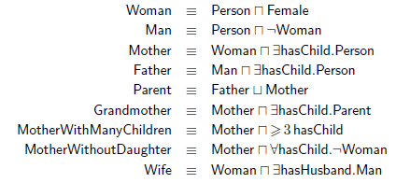
Examples
  a person who has at most one child, or 3 or more children including a daughter

Slide 21
Inference
are all patients satisfying a
set of criteria eligible for reimbursement by insurance?
subsumption: is C⊆D?
reduce to satisfiability
  C∩¬D⊆⊥?
  ⊥ is the “bottom” or NULL concept, nothing is in this set
classification: find all subset relationships in hierarchy
tableau algorithms
  make model by expanding and re-writing concept definitions, or detect failure
PSPACE-complete for ALCN
does there exist
an "only-child" (i.e. with no siblings)
in the database?

Slide 22
Semantic Web
OWL - Web Ontology
  extend data in XML with inference rules (written in RDF)
  SHOIN semantics
  for example, if web page A is annotated with
      <student>
      <name>Joe Smith</name>
      <advisor>Dr. Hank Walker</advisor>
      <institution>TAMU</institution>
      </student>
  then a bot should be able to infer that Dr. Walker is a faculty member at TAMU

Slide 23
RDF Examples
<?xml version="1.0"?>
<rdf:RDF
xmlns:rdf="http://www.w3.org/1999/02/22-rdf-syntax-ns#"
xmlns:cd="http://www.recshop.fake/cd#">
<rdf:Description
rdf:about="http://www.recshop.fake/cd/Empire Burlesque">
<cd:artist>Bob Dylan</cd:artist>
<cd:country>UK</cd:country>
<cd:company>Columbia</cd:company>
<cd:price>10.90</cd:price>
<cd:year>1985</cd:year>
</rdf:Description>

Slide 24
OWL Example: Wine is a liquid, made from grapes (subclass of "things made from grapes"), from a region.
Wine ⊆PotableLiquid∩madeFromGrapes∩∃locatedIn.Region
<owl:Class rdf:ID="Wine">
<rdfs:subClassOf rdf:resource="#PotableLiquid"/>
<rdfs:subClassOf rdf:resource="#madeFromGrapes"/>
<rdfs:subClassOf>
<owl:Restriction>
<owl:onProperty rdf:resource="#locatedIn"/>
<owl:minCardinality>1</owl:minCardinality>
</owl:Restriction>
</rdfs:subClassOf>
</owl:Class>

Slide 25
<CabernetSauvignon rdf:ID="SantaCruzVineyardCabernet" >
<locatedIn rdf:resource="#SantaCruzMountainsRegion"/>
<hasMaker rdf:resource="#SantaCruzMountainVineyard" />
</CabernetSauvignon>
<Region rdf:ID="SantaCruzMountainsRegion">
<locatedIn rdf:resource="#CaliforniaRegion" />
</Region>
<Winery rdf:ID="SantaCruzMountainVineyard" />
<owl:Class rdf:ID="WhiteWine">
<owl:intersectionOf rdf:parseType="Collection">
<owl:Class rdf:about="#Wine" />
<owl:Restriction>
<owl:onProperty rdf:resource="#hasColor" />
<owl:hasValue rdf:resource="#White" />
</owl:Restriction>
</owl:intersectionOf>
</owl:Class>
WhiteWine ⊆Wine∩∃color.White

Slide 26
OWL Example: A "vintage" refers to a specific year (batch) of wine (concept defined by a relation).
<owl:Class rdf:ID="Vintage">
<rdfs:subClassOf>
<owl:Restriction>
<owl:onProperty rdf:resource="#vintageOf"/>
<owl:minCardinality
rdf:datatype="&xsd;NonNegativeInteger">1</owl:minCardinality>
</owl:Restriction>
</rdfs:subClassOf>
</owl:Class>
<owl:ObjectProperty rdf:ID="vintageOf">
<rdfs:domain rdf:resource="#Vintage" />
<rdfs:range rdf:resource="#Wine" />
</owl:ObjectProperty>

Slide 27
OWL: Beers are either lagers or ales (disjoint subclasses)
<owl:Class rdf:about="#Beer">
<owl:equivalentClass>
<owl:Class>
<owl:unionOf rdf:parseType="Collection">
<owl:Class rdf:about="#Lager"/>
<owl:Class rdf:about="#Ale"/>
</owl:unionOf>
</owl:Class>
</owl:equivalentClass>
</owl:Class>
<owl:Class rdf:about="#Lager">
<rdfs:subClassOf rdf:resource="#Beer"/>
<owl:disjointWith rdf:resource="#Ale"/>
</owl:Class>

Slide 28
OWL Example: URIs for describing plants
<owl:Class rdf:about="http://www.linkeddatatools.com/plants#planttype">
<rdfs:label>The plant type</rdfs:label>
<rdfs:comment>The class of all plant types.</rdfs:comment>
<feature:color>green</feature:Color>
</owl:Class>
<!-- OWL Subclass Definition - Flower -->
<owl:Class rdf:about="http://www.linkeddatatools.com/plants#flowers">
<!-- Flowers is a subclassification of planttype -->
<rdfs:subClassOf rdf:resource="http://www.linkeddatatools.com/plants#planttype"/>
<rdfs:label>Flowering plants</rdfs:label>
<rdfs:comment>Flowering plants, also known as angiosperms.</rdfs:comment>
</owl:Class>
<rdf:Description rdf:about="http://www.linkeddatatools.com/plants#orchid">
<!-- Orchid is an individual (instance) of the flowers class -->
<rdf:type rdf:resource="http://www.linkeddatatools.com/plants#flowers"/>
<plants:family>Orchidaceae</plants:family>
</rdf:Description>
plant
flower
orchid
isa
isa

Slide 29
Dublin Core: Ontology for Media
    RDF ontology for digital media, e.g. for information retrieval/media archiving
    has concept definitions for describing books, journals, thesises, newspapers, albums, videos, authors, publishers, ISBN, revisions, affiliations, conferences...
    handles: agents, collections, versions...
<rdf:RDF
xmlns:rdf="http://www.w3.org/1999/02/22-rdf-syntax-ns#"
xmlns:dc="http://purl.org/dc/elements/1.1/"
xmlns:region="http://www.country-regions.edu/">
<rdf:Description rdf:about="https://www.amazon.com/Adventures-
Tom-Sawyer-Mark-Twain/dp/1503215679">
<dc:title>The Adventures of Tom Sawyer</dc:title>
<dc:author>Mark Twain</dc:author>
<dc:date>1876</dc:date>
<dc:language>English</dc:language>
<dc:publisher>American Publishing Company</dc:publisher>
<dc:ISBN>1503215679</dc:ISBN>
</rdf:Description>
</rdf:RDF>

Slide 30
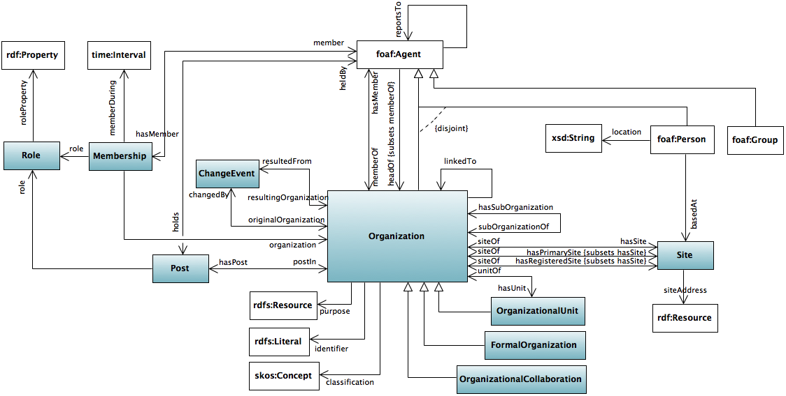
Ontology for Organizations

Slide 31
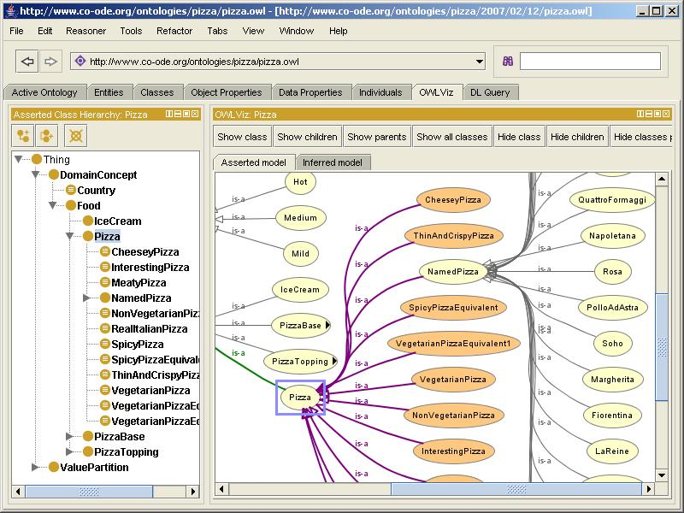
Protege

Slide 32
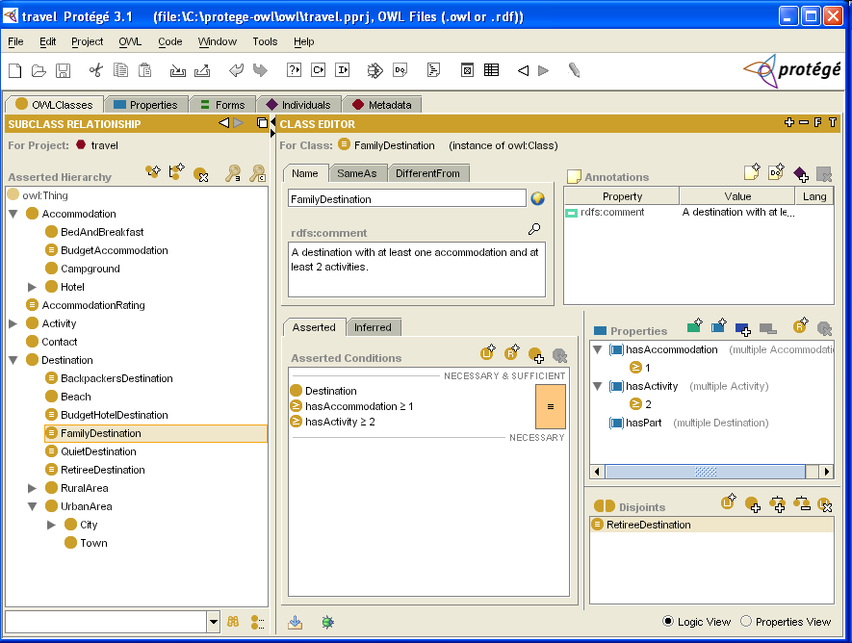

Slide 33
other knowledge representation systems not covered:
  semantic networks; conceptual graphs
  frames
  semantic primitives
  default/nonmonotonic logic; circumscription
  fuzzy logic
  modal logics
  truth-maintenance systems
  Cyc

