Slide 1
Uncertainty in AI

Slide 2

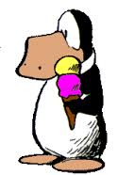

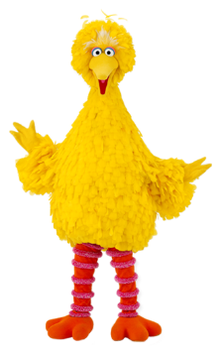
Limitation of First-Order Logic
FOL is not good at handling exceptions
  universal quantifier means ALL; can't say "most" birds fly
  ∀x bird(x)→flies(x)
  asserting bird(opus)∧¬flies(opus) in the KB would cause it to be inconsistent
  FOL is monotonic: if α |= β, then α∧ω |= β
    adding new facts does not undo conclusions
  we could say: ∀x bird(x)∧¬penquin(x) →flies(x)
but we can't enumerate all possible exceptions
  what about a robin with a broken wing?
  what about birds that are made out of plastic?
  what about Big Bird?

Slide 3
Uncertainty in actions:
  If a gun is loaded and you pull the trigger, the gun will fire, right?
  ...unless it is a toy gun
  ...unless it is defective
  ...unless it is underwater
  ...unless the barrel is filled with concrete

Slide 4
Possible Solutions
Add rule strengths or priorities in Expert Systems
  ...an old ad-hoc approach (with unclear semantics)
  penguin(x) →_{0.9} ¬flies(x)
  bird(x) →_{0.5} flies(x)
Other approaches
  Default Logic
  Non-monotonic Logic
  Circumscription
  Semantic Networks
  Closed World Assumption in PROLOG
  ...

Slide 5
Probability
encode knowledge in the form of prior probabilities and conditional probabilities
  P(x speaks portugese|x is from Brazil)=0.9
  P(x speaks portugese)=0.012
  P(x is from Brazil)=0.007
  P(x flies|x is a bird)=0.8 (?)
inference is done by calculating posterior probabilities given evidence
  compute P(cavity | toothache, flossing, dental history, recent consumption of candy...)
  compute P(fed will raise interest rate | employment=5%, inflation=0.5%, GDP=2%, recent geopolitical events...)

Slide 6
Causal vs. diagnostic knowledge
causal: P(x has a toothache|x has a cavity)=0.9
diagnostic: P(x has a cavity|x has a toothache)=0.5
typically it is easier to articulate knowledge in the causal direction, but we often want to use it in a diagnostic way to make inferences from observations

Slide 7

Bayes' Rule
product rule : joint prob P(A,B) = P(A|B)*P(B)
Bayes' Rule: convert between causal and diagnostic
H = hypothesis (cause, disease)
E = evidence (effect, symptoms)

Slide 8

Joint probability table (JPT)
  you can calculate answer to any question from JPT
  the problem is there are exponential # of entries (2^{N}, where N is the number of binary random variables)

Slide 9

Joint probability table (JPT)
  you can calculate answer to any question from JPT
  the problem is there are exponential # of entries (2^{N}, where N is the number of binary random variables)
P(¬cavity | toothache)

Slide 10
Joint probability table (JPT)
  you can calculate answer to any question from JPT
  the problem is there are exponential # of entries (2^{N}, where N is the number of binary random variables)
P(¬cavity | toothache) = P(¬cavity ∧ toothache) / P(toothache)
= 0.016+0.064 /
(0.108 + 0.012 + 0.016 + 0.064)
= 0.4

Slide 11
Joint probability table (JPT)
  you can calculate answer to any question from JPT
  the problem is there are exponential # of entries (2^{N}, where N is the number of binary random variables)
P(¬cavity | toothache) = P(¬cavity ∧ toothache) / P(toothache)
= 0.016+0.064 /
(0.108 + 0.012 + 0.016 + 0.064)
= 0.4

Slide 12
Conditional Independence
Solution to reduce complexity: Employ the Independence Assumption.
Most variables are not strictly independent; most variables are at least partially correlated (but which is cause and which is effect?).
However, many variables are conditionally independent.
A and B are conditionally independent given C if:
P(A,B|C) = P(A|C)P(B|C), or equivalently
P(A|B,C) = P(A|C)

Slide 13
conditional independence gives us an efficient way to combine evidence
  consider P(Cav|toothache,catch)
  using Bayes' Rule:
    P(Cav|toothache,catch) ∝ P(toothache^catch|Cav)P(Cav)
    this requires a mini JPT for all combinations of evidence
  assuming toothache is C.I. of catch given Cavity:
    P(toothache^catch|Cav) = P(toothache|Cav)P(catch|Cav)
    therefore...
    P(Cav|toothache,catch) ∝ P(toothache|Cav)P(catch|Cav)P(Cav)

Slide 14
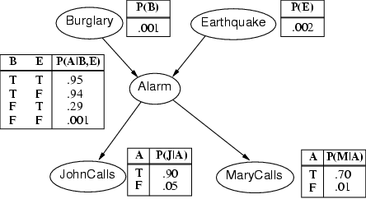
Bayesian networks
note: absence of a direct link between nodes A and B means A is conditionally independent of B given nodes in between (e.g. JohnCalls is C.I. of Burglary given Alarm)

Slide 15

Many modern knowledge-based systems are based on probabilistic inference
  including Bayesian networks, Hidden Markov Models, Markov Decision Problems
  example: Bayesian networks are used for inferring user goals or help needs from actions like mouse clicks in an automated software help system (think 'Clippy')
  Decision Theory combines utilities with probabilities of outcomes to decide actions to tak
the challenge is capturing all the numbers needed for the prior and conditional probabilities
  objectivists (frequentists) - probabilities represent outcomes of trials/experiments
  subjectivists - probabilities are degrees of belief
probability and statistics is at the core of many Machine Learning algorithms

Slide 17
Lumiere (Microsoft) – Office Assistant

Slide 18
Hidden Markov Models
transition probabilities and emission probabilities
Viterbi algorithm for computing most probable state sequence from observations

