Slide 1
Machine Learning
induction vs. deduction
generalization from examples
making AI program adaptive (learn from experience)
types of learning:
  supervised - given labeled example
  unsupervised - given unlabeled observations
  reinforcement - given delayed feedback/rewards

Slide 2
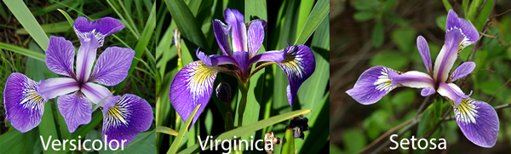
Supervised learning
a "teacher" provides labelled training examples
e.g. a set of positive and negative examples of a target concept
classification tasks: if labels are discrete
petal
sepal
sepal length | sepal width | petal length | petal width | class
5.1 | 3.5 | 1.4 | 0.2 | Iris-setosa
4.9 | 3 | 1.4 | 0.2 | Iris-setosa
4.7 | 3.2 | 1.3 | 0.2 | Iris-setosa
6.2 | 2.9 | 4.3 | 1.3 | Iris-versicolor
5.1 | 2.5 | 3 | 1.1 | Iris-versicolor
5.7 | 2.8 | 4.1 | 1.3 | Iris-versicolor
6.3 | 3.3 | 6 | 2.5 | Iris-virginica
5.8 | 2.7 | 5.1 | 1.9 | Iris-virginica
7.1 | 3 | 5.9 | 2.1 | Iris-virginica
petalLen<-0.66 → setosa
petalLen<0.7 & petalWid<0.59 → versicolor
petalLen>0.6 & sepalWid<0.1 → virgiinca

Slide 3
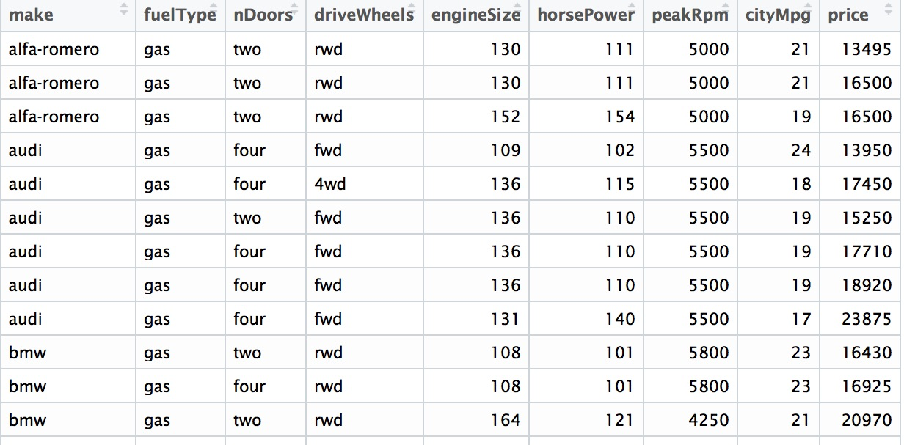
Supervised learning
  prediction tasks: if labels are continuous
example: predicting the price of a car from: make, engine size, # cylinders, horsepower, # doors...
can be handled with neural networks, or multivariate regression (statistics)
"labels"

Slide 4
Supervised learning
with either classification or prediction, supervised learning is like "learning/fitting a function"
  f(SepLen,SepWid,PetLen,PetWid) → {1,2,3}
    range is discrete
  102*engineSize+43*horsepower+12.5*weight +80*#doors-18500 → ℜ (price)
    range is continuous

Slide 5
Unsupervised Learning
learning from unlabeled observations
finding patterns or structure in data
clustering
  noticing that there are a subgroup of monkeys that tend to dominate and lead the group
  identifying a subset of consumers that make bulk purchases of garden supplies repeatedly
associations
  noticing that national birth rates tend to increase at the end of wars
  noticing that local hotel rates go up on football weekends

Slide 6
Reinforcement Learning
learning from sequential episodes
  like a "run" of an agent in an environment over T time steps
payoff/reward might only come at the end
agent needs to perform credit assignment to figure out which actions lead to good outcomes (averaged over many episodes)
a1,a2,a3,a4,a5,a6 -> +521
b1,b2,b3,b4,b5 -> +128
c1,c2,c3,c4,c5,c6,c7 -> +80
d1,d2,d3,d4 -> 809
...

Slide 7
Terminology for Training
training set (set of labeled examples, {<x₁,y₁> <x₂,y₂>...})
  the more examples, the higher the accuracy
feature vector
  constant # of attributes
  includes images (list of pixels)
  other learning methods are for strings (sentences, documents, DNA)...
noise - unavoidable, so algorithms must be robust to it
  could affect feature values, or class lables
  sensor error
  missing information
  non-deterministic
test set
  should be a "independent random sample" from same distribution
accuracy: % correct class labels predicted from f.v. in test set

Slide 8
Learning as Search of Hypothesis Space
a "hypothesis" is a candidate concept description that covers some instances but not others
hypotheses are usually restricted to certain expressions in a language
examples:
  conjunctions: A^C, ¬B^E^¬J
  disjunctions (DNF): (sunny^¬windy)v(cloudy^¬humid)
  linear equations: Y = a₀+a₁X₁+a₂X₂+a₃X₃+...
  polynomials: Y = a₀+a₁X+a₂X²+a₃X³+...
  spheres: examples <p,q> are positive if (p-2)²+(q+1)²<5
- - + + -
- + - -
.

Slide 9
hypotheses correspond to subsets of instances
they can be arranged from most specific (cover 1 ex) to most general (cover all ex)
find the most specific hypothesis that just covers the positive examples but no negative examples
search this
space (H)

Slide 10
there are many more DNF expressions than conjunctions - do we need them?
yes, if the target concept could be disjunctive (like separate clusters of examples in different parts of space
consider learning y=a⊕b=(a^¬b)v(b^¬a)
  cannot be learned with just conjunctions

Slide 11
Space of Hypotheses
determined by form (representation) of hypotheses
a rectangle? sphere? ellipsoid? non-axis-parallel?
multiple rectangles? spheres?
  harder to learn (more parameters), but there could be a better fit (especially if the concept is disjunctive)
C=(0<x<4 & 3<y<6) v (5<x<8 & 4<y<7)

Slide 12
Principles Behind Learning
Consistency
  choose a hypothesis that is most consistent with the data (covers the positive examples but not negatives)
Bias - restrict the space of hypotheses
  constraint on expressiveness
  e.g. to only Boolean conjunctions, or linear equations...
  "No Free Lunch" Theorem - if there is no bias, learning is not possible, because any set of examples can be fit with some hypothesis description

Slide 13
Principles Behind Learning
Simplicity/Parsimony
  Ockham's Razor - all things being equal, prefer the simplest hypothesis that explains the data
Maximum Likelihood
  in cases where no hypothesis in H is perfectly consistent with examples, use probability to choosest "closest" one
  h* = argmax P(h|data) = argmax P(data|h)P(h)
using Bayes' Rule
h∈H
h∈H

Slide 14
Decision Trees
splits are attribute tests, branches are outcomes
leaves have class labels (for making new predictions)
a decision tree can represent any DNF expression
→ LikeToPlayOutdoorSports
test example:
  temp warm
  wind strong
  humidity high
  outlook sunny
classification: No

Slide 15
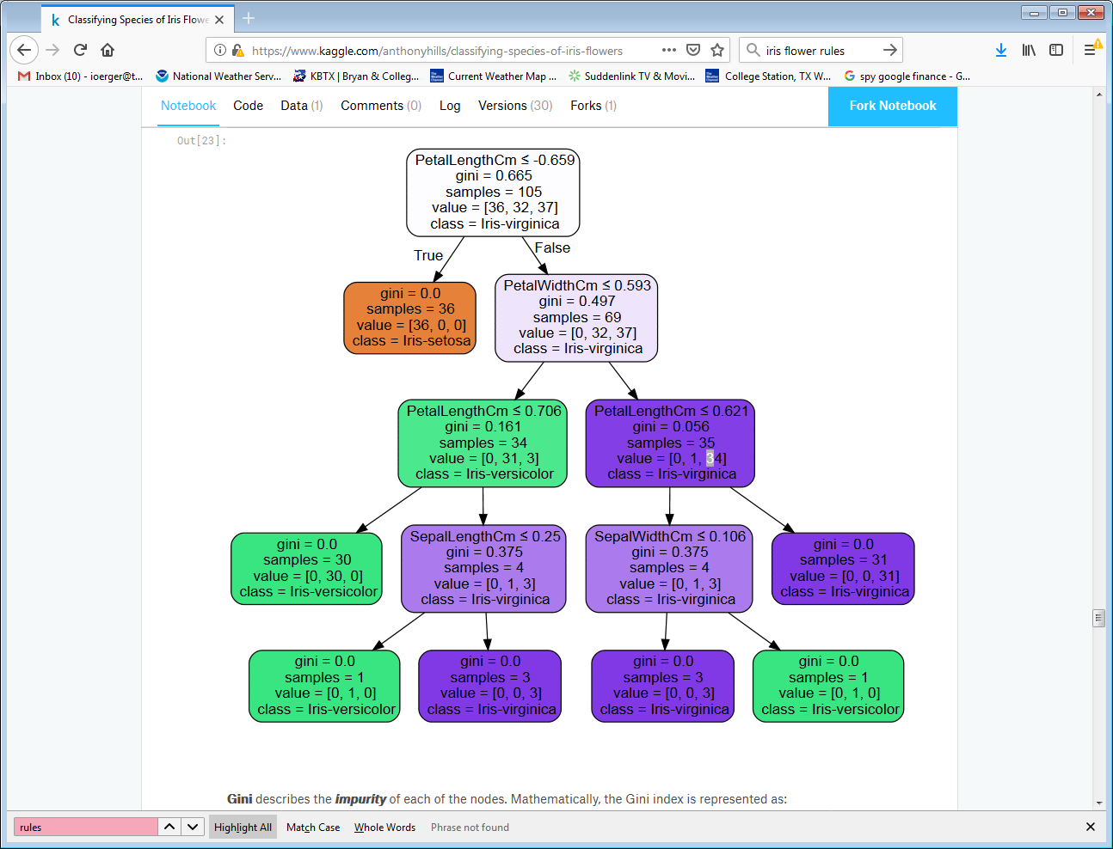

Slide 16
Learning Decision Trees
the space of possible trees is very large - how to find the (smallest) tree that fits the data the best?
greedy approach - build trees top-down
choose best split at root, and then repeat on subsets of examples in each branch (recursion)

Slide 17
also known as ID3, C4.5, CART, PLS0...

Slide 18
Entropy and Information Gain
Importance(): how to choose the optimal split (among all possible attribute tests)?
  choose the split that most reduces the entropy of the training data
high
entropy:
-5/9 log₂ 5/9
-4/9 log₂ 4/9
= 0.991
low
entropy:
-1/9 log₂ 1/9
-8/9 log₂ 8/9
= 0.503

Slide 22
Issues in building decision trees
multiway splits - where test is not just binary (T/F)
handling missing attributes
  what if feature value for a training or test example is "unknown"?
creating splits for continuous attributes, like PetalLength:
vehicleType
sedan pickup SUV motorcycle van

Slide 23
Learning curves
error as a function of # training examples
more data is better, but typically, it plateaus

Slide 24
Cross-Validation
Typically, accuracy is lower on test data
Test set and training set must be separate, but sampled from same distribution
randomly divide all data into k groups, then train on k-1 groups and test on k^{th} group; repeat k times

Slide 25
Overfitting
accuracy is a function of model complexity
bigger dec. trees can be more accurate, have more splits
however, model might be less accurate on test data
splits near fringe of tree are based on only a few training examples, and could be determined by noise

Slide 26
Overfitting
another example: higher order polynomials fit data points better

Slide 27

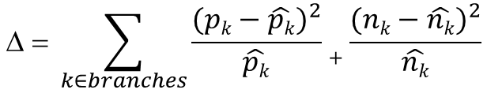
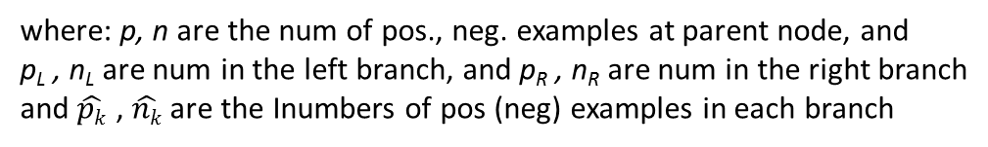

Decision Tree Pruning (methods to avoid overfit)
Approach 1: Chi-squared (χ²) pruning
  use a statistical test to determine which splits are are significant (i.e. which nodes in tree are robust/reliable)
  null hypothesis: the attribute test is irrelevant to the target class, and thus the proportion of positive and negative examples will be approx. the same in each branch as at the parent node
$$\hat{pk}=p\frac{pk+nk}{p+n}$$
$$\hat{nk}=n\frac{pk+nk}{p+n}$$
15 +, 5-
maj class: +
where: p, n are the num of pos., neg. examples at parent node, and
p_{L} , n_{L} are num in the left branch, and p_{R} , n_{R} are num in the right branch
and $\hat{pk}$ , $\hat{nk}$ are the Inumbers of pos (neg) examples in each branch
13+, 4-
maj class: +
2+, 1-
maj class: +
$$\text{D}\text{ = }\sum_{\begin{aligned}k∈branches \\ \end{aligned}}{\frac{{(pk−\hat{pk})}^{2}}{\hat{pk}}+\frac{{(nk−\hat{nk})}^{2}}{\hat{nk}}}$$

Slide 28


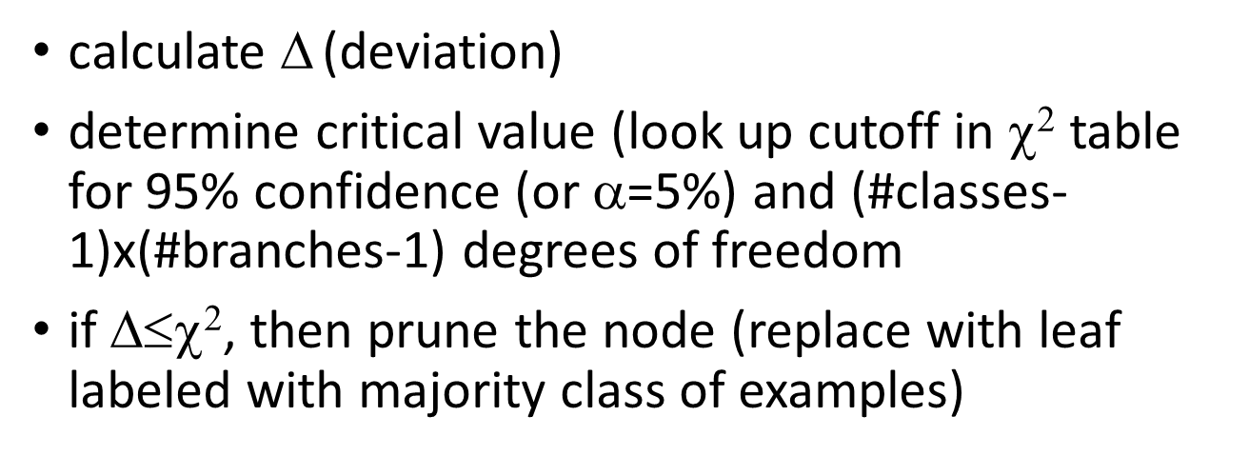


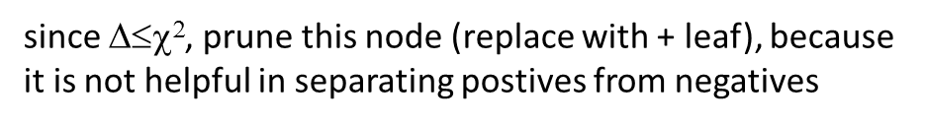
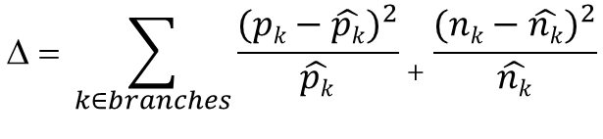

calculate $\text{D}$ (deviation)
determine critical value (look up cutoff in $\text{c}\text{2}$ table for 95% confidence (or α=5%) and (#classes-1)x(#branches-1) degrees of freedom
if $\text{D}≤\text{c}\text{2}$, then prune the node (replace with leaf labeled with majority class of examples)
$\hat{pL}=15\frac{13+4}{15+5}$=12.75
$\hat{nL}=5\frac{13+4}{15+5}$=4.25
15 +, 5-
maj class: +
$\hat{pR}=15\frac{2+1}{15+5}$=2.25
$\hat{nR}=5\frac{2+1}{15+5}$=0.75
$$\text{D}\text{ = }\sum_{\begin{aligned}k∈branches \\ \end{aligned}}{\frac{{(pk−\hat{pk})}^{2}}{\hat{pk}}+\frac{{(nk−\hat{nk})}^{2}}{\hat{nk}}}$$
13+, 4-
maj class: +
2+, 1-
maj class: +
$\text{D}=\frac{\text{(}\text{13}\text{−12.75)}2}{\text{12.75}}$+$\frac{\text{(}\text{4}\text{−4.25)}2}{\text{4.25}}+\frac{\text{(}\text{2}\text{−2.}\text{2}\text{5)}2}{\text{2}\text{.}\text{2}\text{5}}\text{+}\frac{\text{(}\text{1}\text{−}\text{0.7}\text{5)}2}{\text{0.75}}=0.131$
$\text{c}\text{2}\text{a}\text{=0.05,}\text{df}\text{=}\text{1}$ = 3.8415
since $\text{D}≤\text{c}\text{2}$, prune this node (replace with + leaf), because
it is not helpful in separating postives from negatives

Slide 29
Decision Tree Pruning
Approach 2: ReducedError pruning
  set aside a Validation Set (subset, e.g. ~1/3 of training examples) to estimate accuracy of nodes on test data
  identify/remove nodes that would cause excess mistakes on the Validation Set
A
A
B
B
-
B
3+
6-
+
-
+
-
+
-
examples from
validation set:
2+
3-
1+
3-
3+
0-
1+
2-
3+
0-
1+
2-
4 errors with subtree
3 errors with leaf

Slide 30
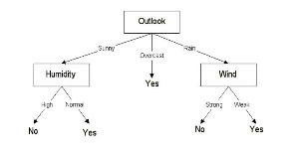
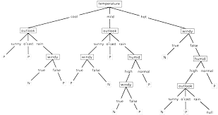
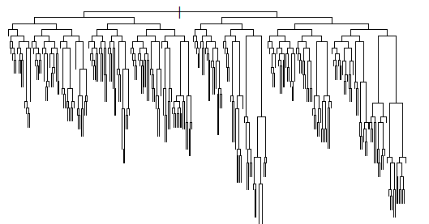
2. eventually, too much
pruning causes error
rate to increase (for very
small trees)
1. as you prune more, the
decision tree becomes more
accurate
from: Mingers (1989). An Empirical Comparison of Pruning for Decision Trees.
Machine Learning journal.

