Slide 1
Intelligent Agents (Ch. 2)
examples of agents
  webbots, ticket purchasing, electronic assistant, Siri, news filtering, autonomous vehicles, printer/copier monitor, Robocup soccer, NPCs in Quake, Halo, Call of Duty...
agents are a unifying theme for AI
  use search and knowledge, planning, learning...
  focus on decision-making
  must deal with uncertainty, other actors in environment

Slide 2
Characteristics of Agents
essential characteristics
  agents are situated:
    can sense and manipulate an environment that changes over time
  agents are goal-oriented
  agents are autonomous
other common aspects of agents:
  adaptive
  optimizing (rational)
  social (interactive, cooperative, multiagent)
  life-like

Slide 3
Goals,
Knowledge Base,
Model of world
sensors,
percepts
State₁
State₂
State₃
State_{n}
plan:
Action₁
Action₂
Action₃
...
actuators,
effectors,
actions
Environment

Slide 4
policy - mapping of states (or histories) to actions
  π(s)=a
  π(s₁,...s_{t})=a_{t}
Performance measures:
  utility function, rewards, costs, goals
  mapping of states (or statesXactions) into R

Slide 5

Rational behavior (rationality)
for each possible percept sequence, a rational agent should select an action that is expected to maximize its performance measure, given the evidence provided by the percept sequence and whatever built-in knowledge the agent has

Slide 6
Task Environments
The architecture or design of an agent is strongly influenced by characteristics of the environment
Discrete | Continuous
Static | Dynamic
Deterministic | Stochastic
Episodic | Sequential
Fully Observable | Partially Observable
Single-Agent | Multi-Agent

Slide 7
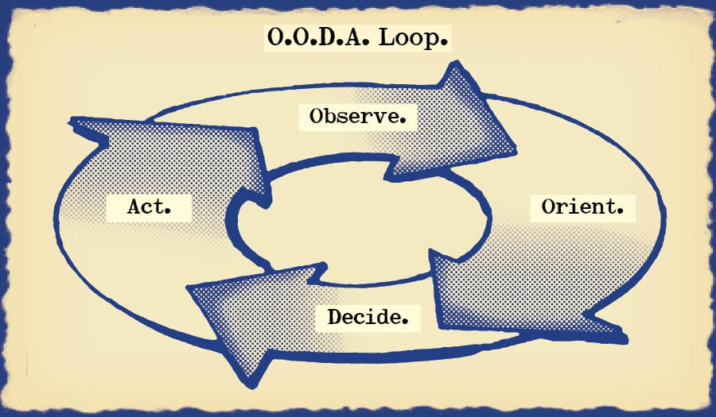
Agent Architectures
Reactive/Reflex Agents
  stimulus-response
  condition-action lookup table
  efficient
  goals are implicit
  sense-decide-act loop
  OODA loop (observe-orient-decide-act)
sense
act decide

Slide 8
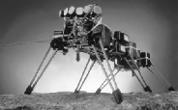
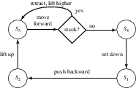
Ghengis
(Rodney Brooks, MIT)
simple
reactive
controllers

Slide 9
Simple Reflex Agent
sensors
What the world is like now
Environment
Condition - action rules
What action I should do now
effectors
function SIMPLE-REFLEX-AGENT(percept) returns action
static: rules, a set of condition-action rules
state ← INTERPRET-INPUT (percept)
rule ← RULE-MATCH (state,rules)
action ← RULE-ACTION [rule]
return action
Stop after First match.
Rules should be prioritized.
A simple reflex agent works by finding a rule whose condition matches the current situation (as defined by the percept) and then doing the action associated with that rule.

Slide 10
Agent Architectures
Rule-based Reactive Agents
  condition-action trigger rules
    if carInFrontIsBraking then InitiateBraking
  more compact than table
  issue: how to choose which rule to fire? (if > 1 can)
    must prioritize rules
implementations
  if-then-else cascades
  JESS - Java Expert System
  Subsumption Architecture (Rodney Brooks, MIT)
    hierarchical - design behaviors in layers
    e.g. obstacle avoidance overrides moving toward goal

Slide 11
Agent Architectures
Model-based Agents
  use local variables to infer and remember unobservable aspects of state of the world

Slide 12
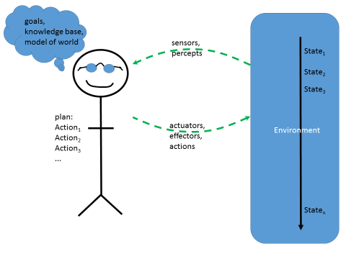
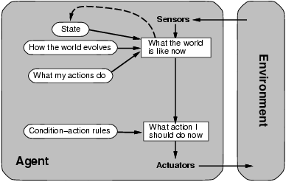
Model-based agent
function MODEL-BASED-REFLEX-AGENT (percept) returns action
static: state, a description of the current world state
rules, a set of condition-action rules
state ← UPDATE-STATE (state, percept)
rule ← RULE-MATCH (state, rules)
action ← RULE-ACTION [rule]
state ← UPDATE-STATE (state, action) // predict, remember
return action

Slide 13
Agent Architectures
Knowledge-based Agents
  knowledge base containing logical rules for:
    inferring unobservable aspects of state
    inferring effects of actions
    inferring what is likely to happen
  Proactive agents - reason about what is going to happen
  use inference algorithm to decide what to do next, given state and goals
    use forward/backward chaining, natural deduction, resolution...
    prove: Percepts∪KB ∪Goals |= do(α_{i}) for some action α_{i}

Slide 14
Agent Architectures
Goal-based Agents (Planners)
  search for plan (sequence of actions) that will transform S_{init} into S_{goal}
  state-space search (forward from S_{init}, e.g. using A*)
  goal-regression (backward from S_{goal})
    reason about effects of actions
  SATplan, GraphPlan, PartialOrderPlan...

Slide 15
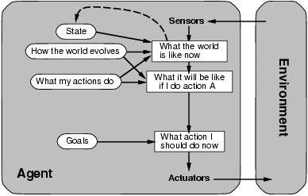
Goal-based agents
Agenda - plan; sequence of things I am in the middle of doing...
  note: plans must be maintained on an agenda and carried out over time - these are intentions

Slide 16
Agent Architectures
Collaborative Agents (multi-agent systems)
  competition vs. collaboration
  "open" agent environment: assume all agents are self-interested (have their own utility function)

Slide 17
Market-based methods for Multi-Agent Systems
mechanisms to incentivize collaboration
  contract networks - agents make bids to do tasks for each other, negotiate price, make commitments
  auctions - agents bid on resources
    first-price, second-price, open vs sealed bid, asc vs descending
    strategy to maximize utility?
    bidding on combinations of resources is more complicated
  consensus algorithms - voting (weight choices by utility)
  do these mechanisms incenvize agents to be rational and bid their true values; free of exploits and manipulation?
  efficiency: do these mechanisms maximize social benefit? (sum of utility of outcomes over all agents)

Slide 18
Methods for Collaborative Agents
Agent Teamwork
  shared goals, joint intentions
    assume teammates are not just self-interested
    teammates can compensate for each other if a team goal is at risk
  well-defined roles, responsibilities
  communication among teammates is key
BDI - modal logic for representing Beliefs, Desires (goals), and Intentions (actions) of other agents
  Bel(self,empty(ammo)) ∧Bel(teammate,¬empty(ammo)) ∧Goal(teammate,shoot(gun)) → Tell(teammate,empty(ammo))

Slide 19
Agent Architectures
Utility-based Agents
  utility function: maps states to real values, quantifies "goodness" of states, u(s)→ℜ
  agents select actions to maximize utility
    sometimes payoffs are immediate (think "reactive")
    othertimes payoffs are delayed:
      Sequential Decision Problems
      maximize long-term reward

Slide 20

Markov Decision Problems (MDPs)
transition function: T(s,a)→S
  outcomes of actions
  could be probabilistic (distribution over successors states)
reward/cost function: R(s,a)→ℜ
“plans” are encoded in policies
  mappings from states to actions: π:S→A
  Markov property: probabilities only depend on current state
the goal: maximize reward over time
  long-term discounted reward
rewards:
r1 r2 r3 r4
a1 a2 a3 s4
s1 s2 s3 s4

Slide 21
how to compute optimal policy π* that maximizes long-term discounted reward?
policy evaluation
  Bellman equations
  value function: utility of each state
  coupled equations, value of each state depends on others
  use dynamic programming
π*(s) = argmax_{a∈Actions} Σ_{s'} T(s,a,s') [R(s,a,s')+γ⋅V*(s')]
intended actions succeed 80% of the time
go off-track 20% of the time
optimal policy, π*

Slide 22
intended actions succeed 80% of the time
go off-track 20% of the time
optimal policy, π*
value function, V^{π*}(s)

Slide 23
Monte Carlo Methods
generate random episodes (action sequences)
take the average long-term disc. reward for episodes passing through each state s
figures borrowed from: Richard Sutton & Andrew Barto (1998, 2018). Reinforcement Learning: An Introduction. avail. online at http://incompleteideas.net/book/the-book.html

Slide 24







Learning a policy for Blackjack (21) using Monte Carlo Reinforcement Learning
player dealer
totals: 15 10
decision: hit or stick?
totals: 19 6
decision: hit or stick?
policy after 500,000 random games

Slide 25
Racetrack (another example that can be modeled and solved as an MDP)
velocity components (v_{x}=Δx/Δt, v_{y}) can be changed by ± 1 each time step; max=5
must avoid skidding into walls (terminates the episode)
reward = { -1 each time step, -∞ if hit wall }
by training on each track, you can learn a policy for controlling acceleration and steering that minimizes time to cross finish line

Slide 26
Value Iteration (Dynamic Programming)
  initialize V₀(s)=0 for all states
  while values in V(s) are still changing...
    triple loop for all states s, actions a, other states s'...
      update V_{i+1}(s) based on V_{i}(s) for all other states
Theorem: Value Iteration converges

Slide 27
further ideas for MDPs
  Reinforcement Learning: learn a policy from feedback, even without having to know T and R (transition function and reward function) a priori
  handling continuous state spaces (use linear functions to represent V(s) instead of tables)

