Slide 1
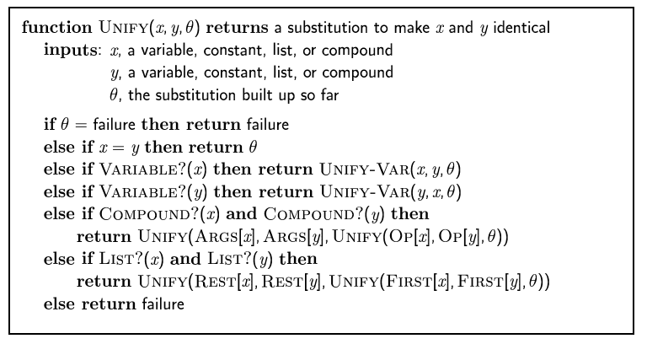
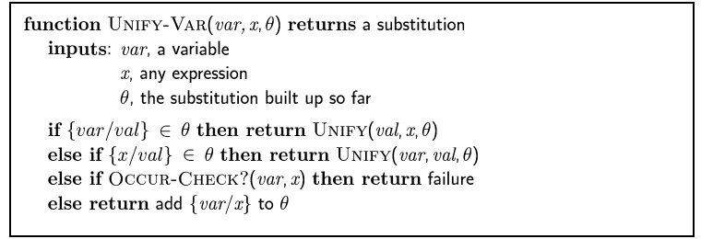

Slide 3
It is a crime for an American to sell weapons to a hostile nation.
1. ∀X,Y,Z american(X)∧weapon(Y)∧hostile(Z)∧sells(X,Y,Z)→criminal(X)
Nono has some missiles.
2. ∃B owns(nono,B)∧missile(B)
All of Nono’s missiles were sold to it by Colonel West.
3. ∀C owns(nono,C)∧missile(C)→sells(west,C,nono)
Missiles are weapons.
4. ∀D missile(D)→weapon(D)
An enemy of America counts as “hostile”.
5. ∀E enemy(E,america)→hostile(E)
The country Nono is an enemy of America.
6. enemy(nono,america)
Colonel West is an American.
7. american(west)

Slide 4
Natural Deduction proof in FOL (with unifiers)
8. hostile(nono) [MP,5,6] θ={E/nono}
9. owns(nono,m₁)∧missile(m₁) [ExInst ,2] θ={B/m₁} skolem constant
10. missile(m₁) [AndElim,9]
11. weapon(m₁) [MP, 10,4] θ={D/m₁}
12. sells(west,m₁,nono) [MP, 3,9] θ={C/m₁}
13. criminal(west) [MP,1,7,8,11,12] θ={X/west,Y/m₁,Z/nono}
From previous page…
1. ∀X,Y,Z american(X)∧weapon(Y)∧hostile(Z)∧sells(X,Y,Z)→criminal(X)

Slide 5
Resolution
generalized resolution - with unifiers

Slide 6
find a pair of clauses that are unifiable
e.g ¬pineTree(P) v plant(P)
pineTree(christmasTree29)
don't forget to
negate the query
apply unifier θ to remaining literals:
e.g. plant(christmasTree29)
termination: we are looking to generate
the empty clause

Slide 9
Resolution Strategies (Search Heuristics)
Unit preference
  choose pairs of clauses where one of them is a single literal
  why? because will reduce length of other clause
Set of Support
  initially identify a subset of clauses likely to contain the inconsistency (e.g. the negated query)
  with each iteration, choose one of the clauses from SOS, and add resolvent to SOS
  generates "goal-directed proofs", without deriving a lot of irrelevant conclusions from a large KB

Slide 10
Input resolution
  always choose one of the clauses from the Input (KB or facts) - never resolve 2 derived clauses
  restricted space of proof trees with a "spine" (see next example)
  efficient, but not complete (except for Horn clause KBs)
Linear resolution
  a variant of Input resolution
  allow clauses to be resolved if one of them is in Input, or if one is an ancestor of the other
  complete

Slide 11
sentences
converted
to CNF

Slide 12
Completeness of Resolution
Recall that Reso in Prop Logic is complete - because of Ground Resolution Theorem:
  If a set of Prop clauses S is unsatisfiable, the empty clause is in the Resolution Closure, so there exists a finite sequence of resolution steps that will generate □
To prove this for FOL, we need to take unification into account (for variables)
Herbrand's Theorem:
  If a set of FOL clauses S is unsatisfiable, then there exists a finite set of ground instances that is unsatisfiable
combine this with the Ground Resolution Theorem and the Lifting Lemma to show that □ can be derive from the original clauses S (with variables)
for example: think of converting
∃x missle(x) and ∀y ¬missile(y)Vweapon(y)
to missile(m₁) and ¬missile(m₁)Vweapon(m₁)

Slide 13
Complexity of Resolution
Recall that showing entailment by Resolution Refutation proofs in Prop Logical is NP-complete
FOL is only semi-decidable
  if entailed (α|= β ), we could prove it (in theory)
  complexity could be much worse than NP-complete
  if β is not entailed, cannot guarantee we can prove it
  because of Gödel's Incompleteness Theorem

